Slide 1
Window Programming 2-5
Time Events
Yuan Ze University

Slide 2
Timer component
Timer component
Generate event every time interval
  Enabled
    timer1.Enable = true;
  Interval
    timer1.Interval = 1000;
  Start()
    timer1.Start();
  Stop()
    timer1.Stop();

Slide 3
DateTime
DateTime
  DateTime.Now Current system time
    Year
      DateTime.Now.Year
    Month
      DateTime.Now.Month
    Day
      DateTime.Now.Day
    Hour
      DateTime.Now.Hour
    Minute
      DateTime.Now.Minute
    Second
      DateTime.Now.Second

Slide 4
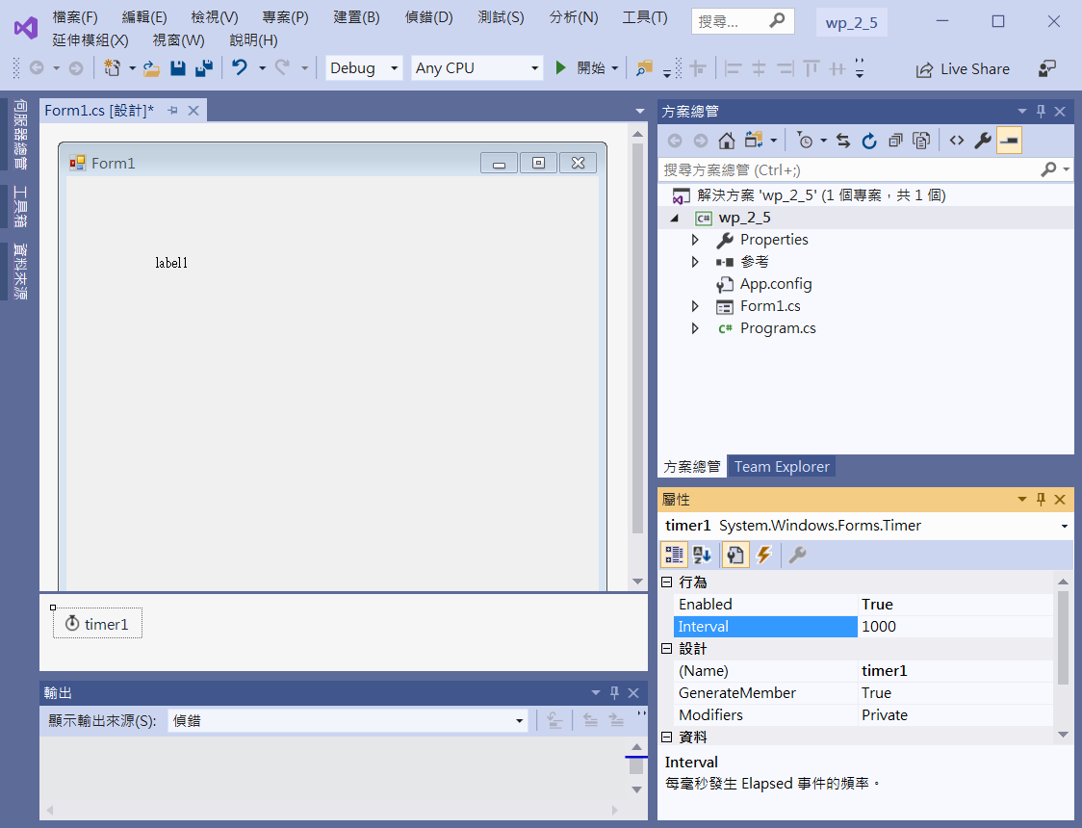
Edit interface
label1
Enabled -> true
timer1
Interval -> 1000

Slide 5
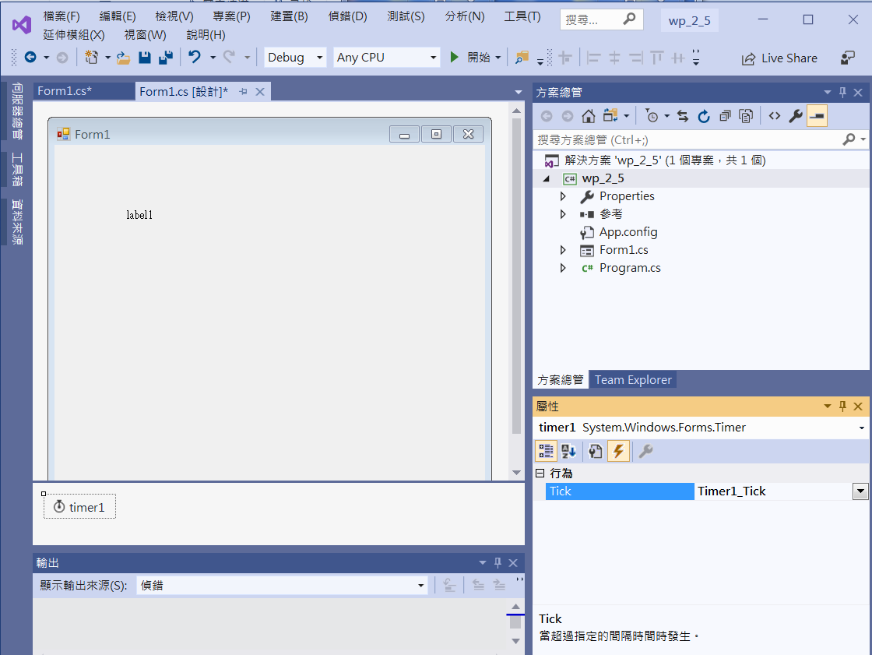
Add event functions
Click at Event
timer1
Double Click at
Tick

Slide 6
Add event functions
private void timer1_Tick(object sender, EventArgs e)
{
label1.Text = DateTime.Now.ToString();
label1.Text += "\n Year: " + DateTime.Now.Year.ToString();
label1.Text += "\n Month: " + DateTime.Now.Month.ToString();
label1.Text += "\n Day: " + DateTime.Now.Day.ToString();
label1.Text += "\n Hour: " + DateTime.Now.Hour.ToString();
label1.Text += "\n Minute: " + DateTime.Now.Minute.ToString();
label1.Text += "\n Second: " + DateTime.Now.Second.ToString();
}
private void Form1_Load(object sender, EventArgs e)
{
label1.Text = DateTime.Now.ToString();
}

Slide 7
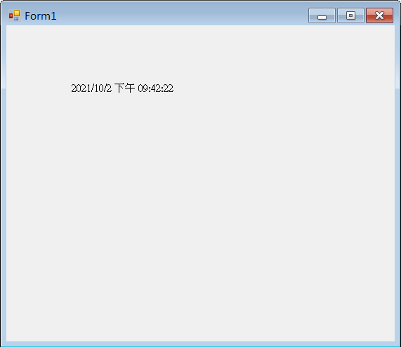
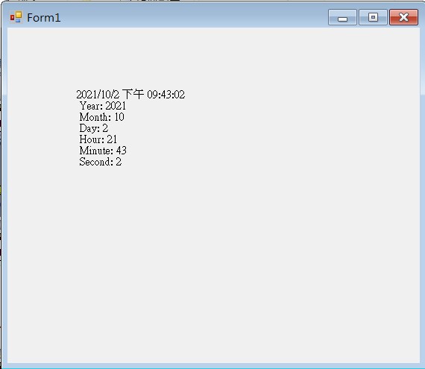
Exercise#2-5

Slide 8
內容來源
  Visual C# 2013視窗程式設計(黃聰明/著; 松崗)
  跟著範例學會Visual C# 2015(張逸中/著; 博碩)

